Slide 1


Robotic Arm BCI
309
8 Credits

Slide 2

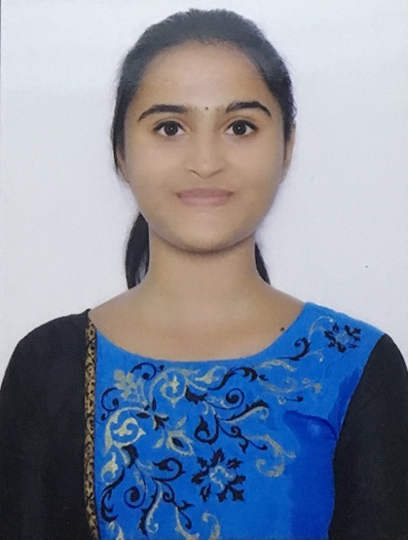

Team composition
SL. NO | Name of the student | SRN | PHOTO
1 | Harshita R Vastrad | PES1201701717
2 | Shreya V Deexit | PES1201701648
3 | V Saisri | PES1201701763
Guide : Dr. B. Niranjana Krupa
Prof. Swetha G

Slide 3
Contents
SERIAL NO | CONTENT
1 | Problem Statement
2 | Motivation
3 | Literature Review
4 | Objectives
5 | Methodology
6 | Block Diagram
7 | Working Principle
8 | Deliverables
9 | Project Timeline
10 | References

Slide 4
Problem Statement
With the popularity of robots, how could the robot help the disabled suffering from neuromuscular injuries has attracted more and more attentions.
The objective here is to use Brain computer interface(BCI) to interact between robot and human, without participation of human hand and assist the patient impaired by neurological conditions
The robotic arm will be able to pick up lightweight objects from one place and drop it as interpreted from the brain waves of the user.

Slide 5
Motivation
Paralysis is one amongst the major neural disorder that causes loss of motion of one or more muscles of the body.Approximately 80% of acute stroke survivors lose arm and hand movement skills. Although the optimal therapy for patients who suffer from stroke is still a point of discussion
The Brain Signals of such patients can be used to help them communicate to others and also to perform various tasks by providing necessary infrastructure and training.
BCI system processes the electrical activity of the brain and generates the commands.
Hence external devices can be controlled using these commands.

Slide 6
Literature Review
(i) C P Shantala,C R Rashmi,“Mind controlled wireless robotic arm”,2017 IEEE International Conference on Computational intelligence and computing research.
Objective : The robotic arm interfacing was done using Matlab and Arduino board. Bluetooth module controls the robotic arm wirelessly.
Dataset : The EEG signals were collected from 14 healthy subjects by using the EEG headset.
Methodology : Three different classification algorithms like SVM, KNN and LDA are considered for classification.
Accuracy : LDA-87.5%
Void : The robotic arm is capable of moving only in 2D plane.Forward and backward movements of the arm are not implemented.

Slide 7
Literature Review
(ii) Ji-Hoon Jeong , Kyung-Hwan Shim , Dong-Joo Kim,Seong Whan Lee,“Brain-Controlled Robotic Arm System Based on Multi-Directional CNN-BiLSTM Network Using EEG Signals”.IEEE Transactions on Neural Systems and Rehabilitation Engineering (Volume: 28 , Issue: 5, May 2020 )
Objective : Decoded the intuitive imagery of users with respect to the arm reaching in 3D multi-direction (left, right, forward, backward, up and down) from EEG signals.
Dataset : EEG signals from 64 channels were continuously recorded according to an international 10–20 electrode position system using BrainAmp devices
Methodology : Brain-controlled robotic arm system based on the MDCBN-based deep learning framework.
Void: It still needs more enhancing decoding performance for all subjects in real-time environments. We plan to adopt advanced deep architectures into the proposed model for guaranteeing robust continuous decoding performance when using more short time-series data.

Slide 8
Literature Review
(iii) Aldwin Jomar F. Castro , Justine Nicole P. Cruzit “Development of a Deep Learning-Based Brain-Computer Interface for Visual Imagery Recognition”, 2020 16th IEEE International Colloquium on Signal Processing & Its Applications (CSPA)
Objective : Evaluates the performance of n deep learning models and traditional classifiers in decoding visual imagery recorded using BCI
Data set : Raw EEG signals for imagined shapes obtained with permission from the previous research done by Nieles et al
Deep learning has the ability to achieve better performance than traditional classification algorithms through adapting its feature selection and weighting of features to different trials, subjects and task
Accuracy : LSTM-87.34%, CNN-Bi-LSTM - 87.46%, SVM-83.06%, LDA-78.12%.

Slide 9
OBJECTIVES
To use brain waves to control robotic arm movement:
-- Involves extracting brain waves from patients and sending the detected signal to robot for arm movement.The outcome of this process is movement of the robotic arm without any motion/gesture in the patients.BCI is used for this purpose.
Image processing for recognition of objects to pick and drop:
-- This process involves object detection. The robot will be able to detect
objects, pick and drop the detected object.

Slide 10
Methodology
Data Acquisition:The EEG signals are collected from patients using the EEG headset and then modified, filtered, digitized and processed.
Signal Preprocessing:Filters are used to remove dc offset.
Filtering: Parks-McClellan optimal FIR filter of range 2–40 Hz can be used for removing the artifacts. The band pass filter of 2–40 Hz is designed because the required bands lie within that range.
Feature Extraction : Transformation of raw signal into feature vector.(Dimensionality Reduction)
The Standard deviation,Variance,Mean are extracted from the decomposed sub-signal obtained from multiwavelet transform.

Slide 11
Classification: The classification of hand movements uses two different scenarios.The two scenarios are as follows:
Imaginary Left and Right hand movements.
Imaginary Up and Down hand movements.
Attention signals are detected using different classifiers.Different classification algorithms like SVM, KNN and LDA can be used for classification.
Object detection: The object detection methods that can be used are:
Faster R-CNNs : Faster R-CNNs are likely the most used method for object detection using deep learning; however, the technique can be difficult to understand,hard to implement, and challenging to train
Single Shot Detectors(SSD):SSDs are a type of convolutional neural network (CNN) architecture, specialized for real-time object detection, classification, and bounding box localization.The algorithm is more straightforward than Faster R-CNNs.
Brain-Controlled Robotic Arm using BCI

Slide 12
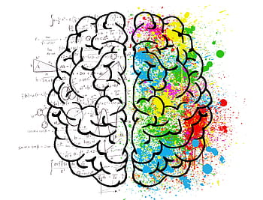
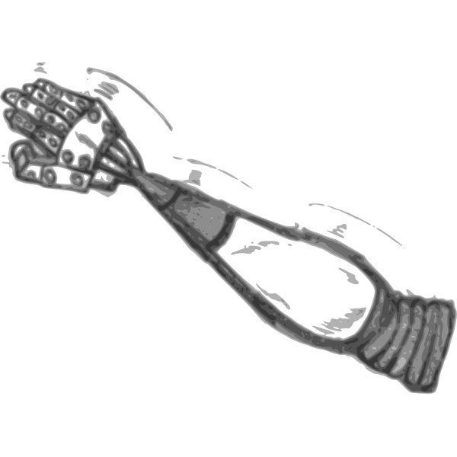
Block Diagram
DATA ACQUISITION
(EEG Signal)
SIGNAL PROCESSING
1
2
PRE PROCESSING
FEATURE
EXTRACTION
CLASSIFICATION
Raspberry
Pi
Raspberry Pi Camera
3
4
EEG SIGNAL
CLASSIFICATION RESULT (LEFT,RIGHT MOVEMENT)
DELIVERS HIGH RESOLUTION IMAGE
COMMANDS(LEFT,RIGHT,PICK,DROP)
APPLICATION
ROBOTIC ARM

Slide 13
Working Principle
The four class motor imagery dataset is used.
Preprocessing of the obtained data has to be done to remove artifacts(dc offset).
Various features are extracted and classified using LDA Classifier.
The output of the Classifier is given to Raspberry pi.
Raspberry pi moves the robotic arm in the direction of the received command.
After completion of the classification part,object detection has to be done.This can be implemented using CNN.
When object is detected, the robotic arm picks up the object and drops it at destination.

Slide 14
Deliverables
Signal Processing
Object Detection
Mechanical Arm
Brain Controlled Robotic Arm
At the end of the project:
Brain Controlled Robotic Arm System.

Slide 15
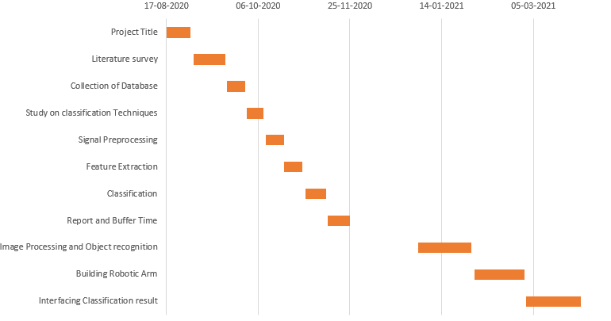
Project timeline

Slide 16
References
O. Damm, K. Malchus, P. Jaecks, S. Krach, F. Paulus, M. N-Aber, “An Eye tracking study”.Different gaze behavior in human-robot interaction in asperger's syndrome.
Walid Zgallai, John Teye Brown, Afnan Ibrahim, Fatma Mahmood, Khulood Mohammad, Maitha Khalfan, Maryam Mohammed, Maryam Salem, Noof Hamood, “Deep Learning AI Application to an EEG driven BCI Smart Wheelchair”, 2019 Advances in Science and Engineering Technology International Conferences (ASET)
C P Shantala,C R Rashmi,“Mind controlled wireless robotic arm”,2017 IEEE International Conference on Computational intelligence and computing research.
Ji-Hoon Jeong , Kyung-Hwan Shim , Dong-Joo Kim,Seong Whan Lee,“Brain-Controlled Robotic Arm System Based on Multi-Directional CNN-BiLSTM Network Using EEG Signals”, IEEE Transactions on Neural Systems and Rehabilitation Engineering (Volume: 28 , Issue: 5, May 2020 )

Slide 17
Thank You…

